Slide 1
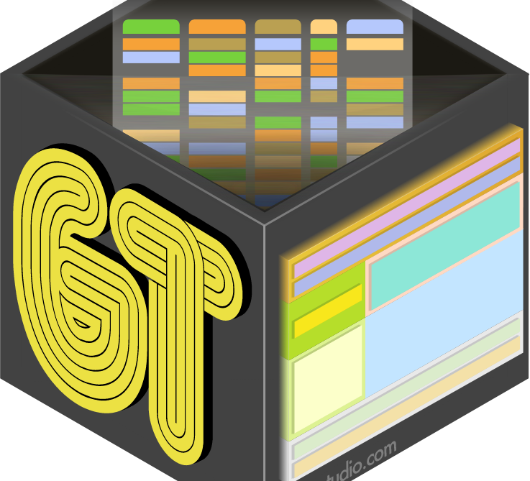
GT Package
Mohammed AlKhamis
Team#4

Slide 2
Title of Content
Introduction
GT Table Parts
GT Workflow
Demo
References
Functions for Making Display Tables

Slide 3

Introduction
GT Package: is a package that transform the data-frame to a nice-looking table.

Slide 4
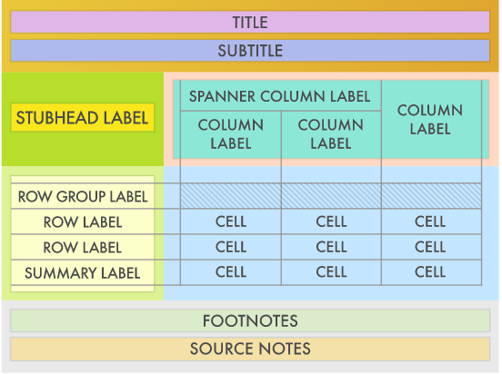
GT Table Parts
Table Header
Column Labels
STUB
Table Body
Table Footer

Slide 5
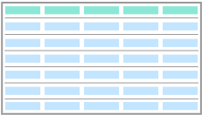
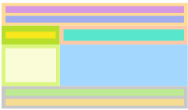
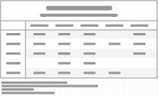
GT Workflow
The Data
Earthier Tibble or Data-Frame
GT Object
GT Table
Output as HTML

Slide 6
Functions for Making Display Tables
Create Table
gt() Create a gt table object
Create/Modify
tab_header() Add a table header
tab_row_group() Add a row group
tab_footnote() Add a footnote
tab_source_note() Add a source note citation

Slide 7
Functions for Making Display Tables
Create Table
gt() Create a gt table object
Format the data
fmt_number() Format numeric values
fmt_scientific() Format values to scientific notation
fmt_percent() Format values as a percentage
fmt_curremcy() Format values as currency
fmt_date() Format values as dates
ftm_time() Format values as time
fmt_datetime() Format values as date-time
fmt_missing() Format missing values
Table Body

Slide 8



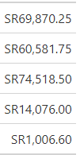
Functions for Making Display Tables
Create Table
gt() Create a gt table object
Format the data
fmt_number() Format numeric values
fmt_scientific() Format values to scientific notation
fmt_percent() Format values as a percentage
fmt_curremcy() Format values as currency
fmt_date() Format values as dates
ftm_time() Format values as time
fmt_datetime() Format values as date-time
fmt_missing() Format missing values

Slide 9
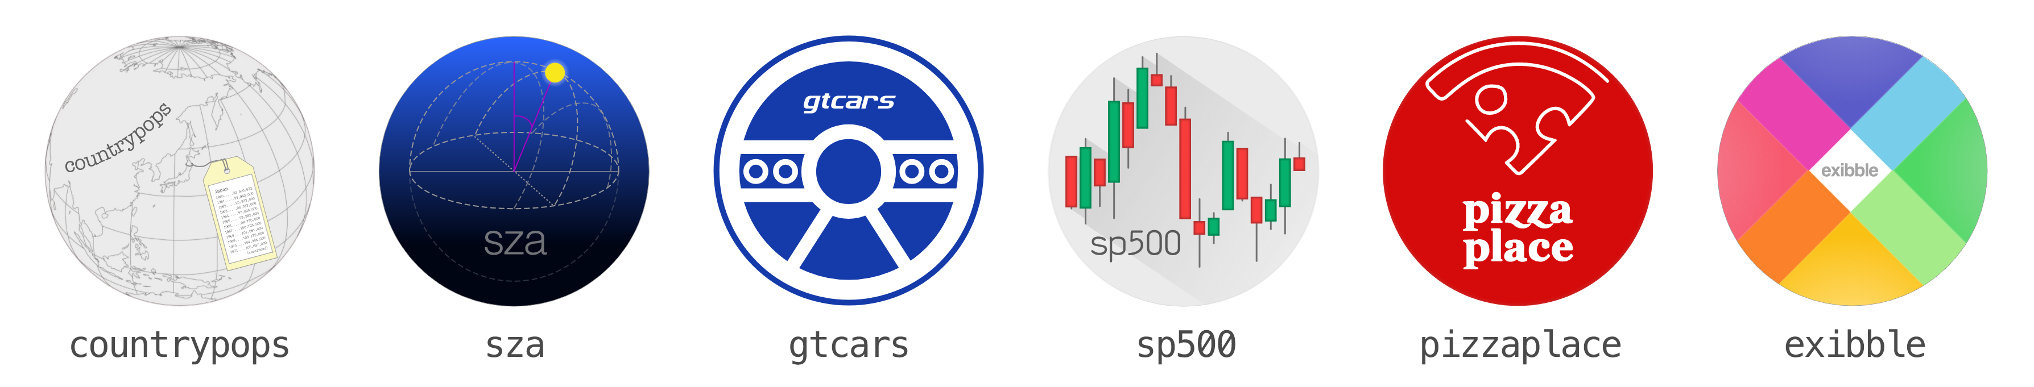
GT Package Data Sets

Slide 10
Let's go to the Demo

Slide 11
References:
Websites:
https://gt.rstudio.com/
The Mockup Blog: gt - a (G)rammar of (T)ables
YouTube Videos:
https://www.youtube.com/watch?v=h1KAjSfSbmk&t=714s
https://www.youtube.com/watch?v=ZWcllDBfjmc
For Python users:
Table Visualization — pandas 1.3.4 documentation (pydata.org)
Dataframe Styling using Pandas | Tables - Mode

Slide 12
Thank You!

